Slide 1

Preflight Check List
Everyone:
Sign into our Zoom meeting through our integrated Blackboard/Zoom link
Make sure that you can hear the conversation, see shared desktops, and view group chat topics
You will need a headset with a microphone to be able to effectively listen and speak
You will need to be able to share your computer screen
Thank you if you choose to leave your camera on to help make our class more interactive
In person participants also:
Make sure that your microphone and speakers are muted/off so that we don’t get an echo
Sit in a good spot near the classroom ceiling microphones if possible
Start Recording

Slide 2
Agenda:
Prework and Announcements
Scrum Team Review of Maintenance
Preview: Scrum Team Sprint 0 Delivery
Quiz 5
Prework for Next Class
Scrum Team Sprint 0 Delivery
Discussion & Questions welcome at any time but please be present with no phones or email during our time together

Slide 3
Prework
Complete through activity 9 prior to next class
Be prepared for a scrum team chapter 9 on Software Maintenance
Be prepared for quiz 5

Slide 4
Scrum Team Review of Maintenance
Assign presenter
Team reviews key topics using “team number by percent of content” method
Team sits back, relaxes, and acknowledges the bravery and dedication of the presenter
Sections:
9.1 What Makes Code “Legacy” and How Can Agile Help?
9.2 Exploring a Legacy Codebase
9.3 Establishing Ground Truth With Characterization Tests
9.4 Comments and Commits: Documenting Code
9.5 Metrics, Code Smells, and SOFA
9.6 Method-Level Refactoring
9.7 The Plan-And-Document Perspective on Working With Legacy Code
9.8 Fallacies and Pitfalls
9.9 Concluding Remarks: Continuous Refactoring

Slide 5
Software Maintenance & Support
Many processes include both Software Maintenance and Software Support in a single Maintenance category. This is a grave disservice from a process perspective because the two activities are dissimilar in many ways including:
The processes are aligned to different audiences with support focusing on application users and maintenance focusing on application sponsors
Support needs to scale with the user base where maintenance scales with enhancement requests
The optimal process is different with support generally adopting a Kanban and issue ticketing process where maintenance following a software development process like Waterfall or Agile
Support is optimized by supporting all products associated with a user base where maintenance is more single product focused
The cadence of support is minutes and hours where maintenance is days, weeks, and months which can make it challenging to balance the immediate vs the important daily activities
Notes:
Grace period until Monday morning a 6am CT

Slide 6
Characteristics of a Good Metric
What makes a good software quality metric?
Easy to collect and understand
Good approximation of reality and good correlation to quality & goals
Meaningful to the group that can deliver positive change and can drive positive actions
Meaningful over time to encourage positive trends
Discourages “gaming the system,” or at least limits the impact of “gaming”
Does not allow one group to declare success (project management, developers, business analysts, etc.) while the overall product is failing
Comparable across teams, companies, and the industry

Slide 7
Common Metrics for Software Development
Line of code per time-period
On-time
On-budget
… Scope delivered
Defects
Weighted Defects
Weighted Defects per unit delivered
Unit delivered per hour/day/month… per person
Unit delivered per hour/day/month… per dollar

Slide 8

Common Metrics for Agile Software Development
Story Points per Sprint per person
Say/Do ratio
Story Points delivered per Sprint… change in Story Points delivered per Sprint
Team versatility
Percent coverage with automated testing or with Test-Driven Development
Satisfaction surveys with internal or external customers
Eric’s Favorite: Weighted Defect Density per 10,000 hours worked… production

Slide 9
Preview: Scrum Team Sprint 0 Delivery

Slide 10
Recall Perspectives & Priorities
Perspectives:
Process
Technology
Customer (User)

Slide 11
Recall Perspectives & Priorities
Process:
Waterfall
Iterative
Agile
CMMI and ISO
Technology:
Architecture & Design,
Languages, Tools, and Platforms
Customer (User):
Epics, Features, Stories

Slide 12
Recall Perspectives & Priorities
Agile Priorities:
Customer
Technology
Process

Slide 13
Quiz 5

Slide 14
Prework
Be prepared for scrum team sprint 1 planning

Slide 15
End of Session

Slide 16
Friendly Conversation Topic

Slide 17
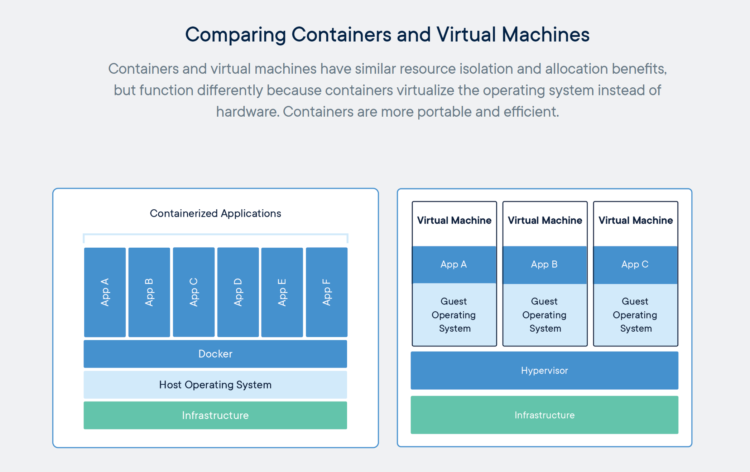
Containers & Docker [link]

Slide 18
Kubernetes & Swarm [link]

Slide 19
Metrics

Slide 20
Submission Percentage from Sprint 1

Slide 21
Submission Percentage from Sprint 2

Slide 22
Submission Percentage for Sprint 3

Slide 23
Submission Percentage for Sprint 4

Slide 24
Prework
Complete through activity 5 prior to next class
Be prepared for a scrum team chapter 9 on Software Maintenance
Scrum Team Review of Software Maintenance
Metrics

Slide 25
Waterfall vs Iterative vs Agile Requirements
 | Waterfall | Iterative | Agile
References | United States Department of Defense: DOD-STD-2167A (1985) | Rational Unified Process (RUP) Open Unified Process | Scrum Kanban Scaled Agile Framework (SAFe)
Priorities | Planning and predictability | Architecture, modeling, and efficiency through early detection & fixing of issues (verification) | Responsiveness to feedback, efficiency through engineering practices, early detection & fixing of issues, and validation
Principles | Execute phases sequentially: Requirements Analysis Design Coding Testing / Validation and Operations Define and commit to Scope, Cost, and Timeline “early” Implement strict Change Control | Manage requirements Develop and test iteratively Validate quality iteratively Use components Model visually Control changes | Capture lightweight near term requirements Allow requirements to evolve but maintain fixed timelines Develop, test, deploy, and release iteratively Validate and Verify quality iteratively Empower teams Apply engineering practices and systems thinking Integrate early user feedback into remaining plan Maintain a collaborative approach between all stakeholders
Notes:
The views on testing and change management have changed dramatically as organizations have moved from Waterfall to Iterative to Agile development lifecycles.
Successful Agile (and Iterative) Development REQUIRES better application design, development techniques, and testing practices.
Testing and lack of defects are not the end goal. A higher quality more usable more cost-effective product is the goal.
Requirements:
Waterfall:
Full project requirements upfront
Inconsistent industry capture techniques
Tend to be verbose requirements with formal signoff
Change requests needed
Estimation bottom up detailed estimates sometimes function points
Iterative:
Mostly upfront

